Slide 1
Predicting readmission risk
Sowjanya Gowrisankaran
Leong Hui Wong

Slide 2

Overview
Analytic model to predict inpatient readmissions
Need for change
Proposed solution
Implementation & evaluation

Slide 3

14.9% of hospitalizations are readmitted within 30 days
In comparison, Oregon HTPP hospitals: 11.8 % (2017)
https://www.oregon.gov/oha/HPA/ANALYTICS-MTX/Documents/HTTP-Year-4-Report.pdf
https://www.scripps.org/sparkle-assets/images/emergency_room_600_x_375_web.jpg
Notes:
5169/(29363+5169)
Readmit30 = 1 / (readmit30 = 1 + readmit30 = 0)
Oregon Hospital Transformation Performance Program (HTPP)
“An admission to an acute care hospital within 30 days of discharge from an acute care hospital.”
Horwitz L, Partovian C, Lin Z, Herrin J, Grady J, Conover M, Montague J, Dillaway C, Bartczak K, Ross J, Bernheim S. Hospital-wide all-cause unplanned readmission measure: final technical report. Centers for Medicare and Medicaid Services. 2012 Jul.

Slide 4
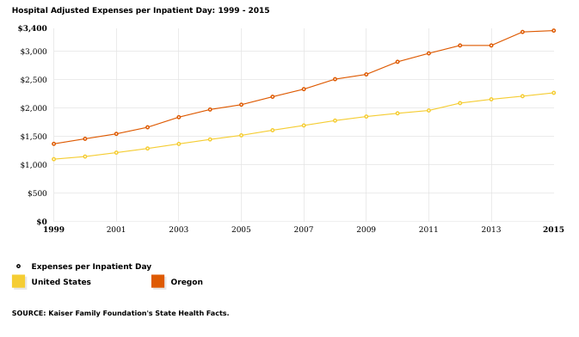
Est. cost per admission: $13.6k
(as of 2015)
https://www.kff.org/state-category/health-costs-budgets/hospital-inpatient-day-expenses/
Notes:
Median LOS = 4 days
$3,400 x 4 days = $13,600

Slide 5

Hospital Readmissions Reduction Program
CMS withheld $526 million (FY2017)
KP facilities are among those penalized
E.g. Kaiser Foundation Hospital And Rehab Center, Vallejo, CA ( 0.25% )
https://www.cms.gov/Medicare/Quality-Initiatives-Patient-Assessment-Instruments/Value-Based-Programs/HRRP/Hospital-Readmission-Reduction-Program.html
https://kaiserhealthnews.files.wordpress.com/2016/08/medicarereadmissionpenaltiesyear5_pdf_final1.pdf

Slide 6
Why change now?
Increasing inpatient expenditure
CMS may increase penalties or add conditions to HRRP
1
3
2
Increasing patient load from acquisitions and growth
4
CMS to implement readmission penalties in nursing homes
https://www.cms.gov/Medicare/Quality-Initiatives-Patient-Assessment-Instruments/Value-Based-Programs/Other-VBPs/SNF-VBP.html
Notes:
acute myocardial infarction (AMI)
heart failure (HF)
pneumonia
chronic obstructive pulmonary disease (COPD)
elective primary total hip and/or total knee arthroplasty (THA/TKA)
coronary artery bypass graft (CABG) surgeries

Slide 7
Analytic Solution - LACE Score
The model we propose uses a LACE score to predict patient readmissions within 30 days.
Using this model, we can:
Identify high-risk patients
Focus interventions to reduce readmissions
Improve quality of care and patient satisfaction
Reduce re-admissions
Notes:
We propose the use of a LACE score to predict readmission risk among patients.
This score can be used potentially to stratify patients by their risk for readmission, enabling care coordinators, nurses and physicians to appropriately channel effort and resources to better manage the transition of care for patients. Reduced readmissions could lead to improved quality of cae and patient satisfaction.

Slide 8
LACE Score
The score is a number between 0 and 19
L – Length of Stay
A – Acuity
C – Co-morbidity (CHF and Stroke)
E – Emergency room visits in the past 6 months
van Walraven C, Dhalla IA, Bell C, Etchells E, Stiell IG, Zarnke K, Austin PC, Forster AJ. Derivation and validation of an index to predict early death or unplanned readmission after discharge from hospital to the community. Canadian Medical Association Journal. 2010 Apr 6;182(6):551-7.
Notes:
The four components of the LACE score are the Length of Stay (for how many days the patient was admitted), the Acuity which depends on whether the in patient admit was through the ER or not, the presence of co-morbidities (for this model it specifically meant the presence or absence of CHF and CVD), and the number of ER visits the patient has had in the past 6 months from the date of admission to the hospital. The sum of these four components is the LACE score, which could range from 0 to 19.
The data for the calculating the LACE score and modeling is abstracted from the EHR (Patient encounter data, ICD codes for diagnosis) of 34532 patients.
The use of the LACE score model has been tested and validated by a group in Canada and has been implemented successfully at other locations within the hospital network.
And when the LACE score is used in a logistic regression model to predict the readmission, it turns out to be statistically significant.
A one unit increase in LACE score leads to about a 21% increase in odds of being readmitted.

Slide 9
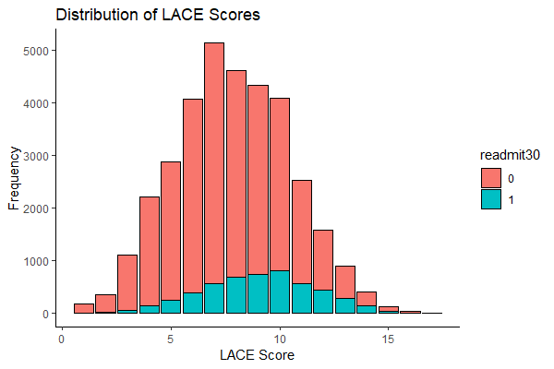
Notes:
This plot shows the distribution of the data used to build the LACE score model.
About 15% of patients admitted in the hospital end up being readmitted within 30 days of discharge.
Although the distributions of LACE scores for these two populations overlap, on an average patients who get readmitted tend to have a higher LACE score.
myplot2 <- ggplot(data = laceTable, mapping = aes(x=laceScore, fill=readmit30)) + geom_bar(color = "black") + xlab("LACE Score") + ylab("Frequency") + ggtitle("Distribution of LACE Scores")
# https://felixfan.github.io/ggplot2-remove-grid-background-margin/
myplot2 + theme_bw() + theme(panel.border = element_blank(), panel.grid.major = element_blank(), panel.grid.minor = element_blank(), axis.line = element_line(colour = "black"))

Slide 10
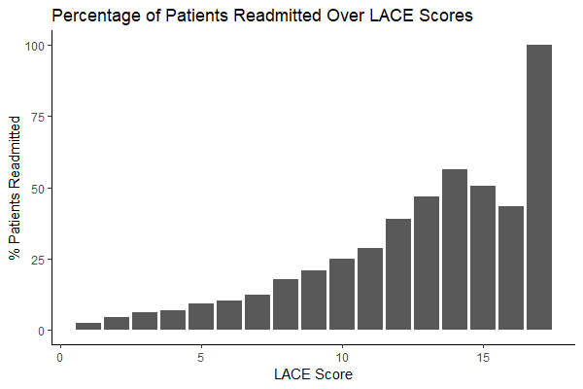
Notes:
This plot shows is that as the LACE score increases, there is a greater chance for the patient to be readmitted. This suggests that it could be a useful measure to predict readmissions.
myplot <- ggplot() + geom_bar(aes(x=c(1:17),y=percentage), stat='identity') + xlab('LACE Score') + ylab('% Patients Readmitted') + ggtitle('Percentage of Patients Readmitted Over LACE Scores')
# https://felixfan.github.io/ggplot2-remove-grid-background-margin/
myplot + theme_bw() + theme(panel.border = element_blank(), panel.grid.major = element_blank(), panel.grid.minor = element_blank(), axis.line = element_line(colour = "black"))

Slide 11
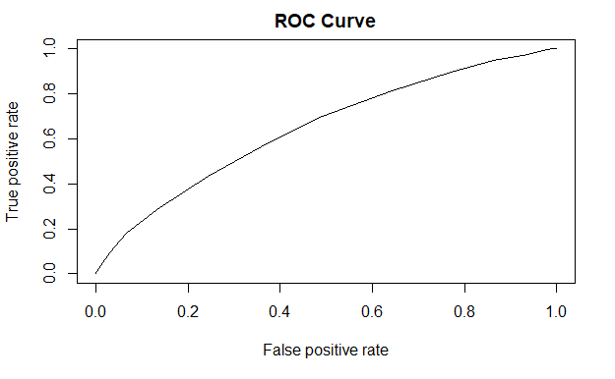
Re-admission = Intercept + Total LACE Score
Area under the curve: 0.648
Notes:
Slot "y.values": [[1]] [1] 0.6476649

Slide 12
Model Performance
True Readmit | Model Prediction |  | Total
 | Not Readmitted | Readmitted
Not Readmitted | 2975 | 2858 | 5833
Readmitted | 319 | 739 | 1058
Total | 3294 | 3597 | 6891
Sensitivity: 69.8% Specificity: 51%
Notes:
35432 *0.15 = 5180
5180*0.7 = 3626 identified, and if it can be avoided results in about (3636*13600=$49,449,600) Even if half of these admits are avoided it results in significant cost savings.
Even if 50% are readmissions that are avoided:
Positive Predictive value: 20.5% Negative Predictive value: 90.3%
The LACE score as a single predictor is moderately discriminatory of 30 day readmissions.
By identifying 70% of possible readmissions, there is a better chance of reducing the number of readmissions and increasing the costs saved from the reduced readmissions and reduced penalties.
34532 patient data points used
Model trained on 80% data and tested on 20% data
Validation of the LACE score will be performed following implementation

Slide 13
Implementation Plan
(People) Engage, involve, and educate users
(Process) Usability and change management
(Technology) Pilot program - rapid prototyping and agile methodology
Time to value = 1.5 years
Notes:
Communication strategy: department / staff meetings, journal clubs, roadshows
Hospitalists / palliative
Transition care nurses / pharmacists
Care coordinators
Integrate into existing workflow
Easy access in reports and lists
Clear guidance to next steps

Slide 14
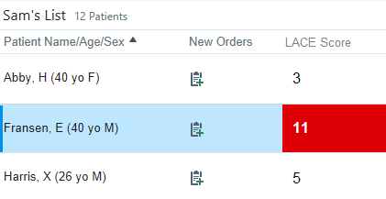
Mockup in Epic Patient List
Notes:
Design custom print group
Add LACE Score column

Slide 15
Evaluation Plan
Process measures
Adoption rate (logs / survey)
Misclassification / error rate (audit / ad-hoc)
Outcome measures
User knowledge and satisfaction (survey)
All-cause and preventable readmissions pre- and post-implementation (time series)

Slide 16
Risks and Limitations
Model
Re-evaluation based on additional parameters
Implementation
Vendor / platform dependent
Unforeseen data quality issues
Workflow incompatibility or user resistance
Evaluation
Ongoing validation and audit

Slide 17
Action Items for Management
SMEs and funding to build and maintain model:
IT, informatics, analytic lead (CFO, CIO, CMIO)
CAPEX: $200k, 4 FTE
OPEX: $20k/yr, 0.5 FTE
To support change management and drive adoption:
Clinician champions (CMO, CNO, dept heads)
Senior management (COO, CIO, CMIO)
Notes:
Reducing Readmission as corporate quality agenda

Slide 18
Thank you

